Slide 1
Introduction to Programming
Kal Academy

Slide 2
What is a computer?
A computer is an electronic device that stores and processes data
It includes both hardware and software
A computer consists of the following major hardware components:
A central processing unit (CPU)
Memory (main memory)
Storage devices (such as disks and CDs)
Input devices (such as the mouse and keyboard)
Output devices (such as monitors and printers)
Communication devices (such as modems and network interface cards)
A computer’s components are interconnected by a subsystem called a bus.

Slide 3
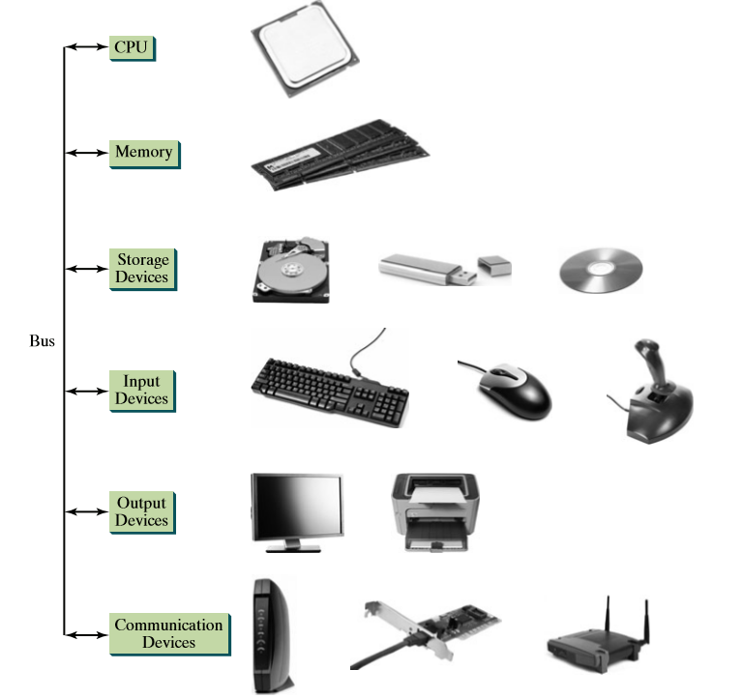
Hardware components

Slide 4
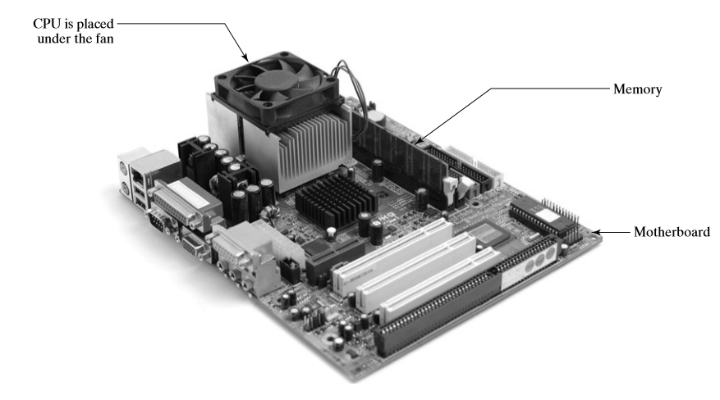
Central Processing Unit – the brain

Slide 5
Bits and Bytes
A computer is really nothing more than a series of switches
Each switch exists in two states: on or off.
If the switch is on, its value is 1. If the switch is off, its value is 0.
These 0s and 1s are interpreted as digits in the binary number system and called bits (binary digits).
The minimum storage unit in a computer is a byte.
A byte is composed of eight bits.

Slide 6
Storage capacity
A computer’s storage capacity is measured in bytes and multiples of the byte, as follows:
A kilobyte (KB) is about 1,000 bytes.
A megabyte (MB) is about 1 million bytes.
A gigabyte (GB) is about 1 billion bytes.
A terabyte (TB) is about 1 trillion bytes.
A typical one-page word document might take 20 KB.
So 1 MB can store 50 pages of documents and
1 GB can store 50000 pages of documents.
A typical two-hour high-resolution movie might take 8 GB.
So it would require 160 GB to store 20 movies.

Slide 7
Programming Languages
Computer programs, known as software, are instructions that tell a computer what to do.
Computers do not understand human languages, so programs must be written in a language a computer can use.
Three kinds of Languages:
Machine Language
Assembly Language
High-Level Language

Slide 8
Machine Language
A computer’s native language, which differs among different types of computers, is its machine language—a set of built-in primitive instructions.
These instructions are in the form of binary code.
For example, to add two numbers, you might have to write an instruction in binary code, like this:
1101101010011010

Slide 9
Assembly Language
Programming in machine language is a tedious process.
Programs written in machine language are very difficult to read and modify.
For this reason, assembly language was created in the early days of computing as an alternative to machine languages.
Assembly language uses a short descriptive word, known as mnemonic, to represent each of the machinelanguage instructions.
add 2, 3, result

Slide 10
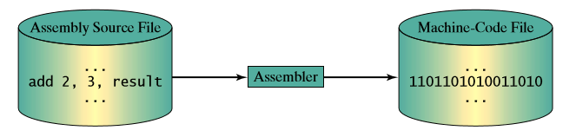
Assembler
An assembler translates assembly-language instructions into machine code.

Slide 11
High-level languages
High-level languages are English-like and easy to learn and use.
In the 1950s, a new generation of programming languages known as high-level languages emerged.
They are platform-independent, which means that you can write a program in a highlevel language and run it in different types of machines.

Slide 12
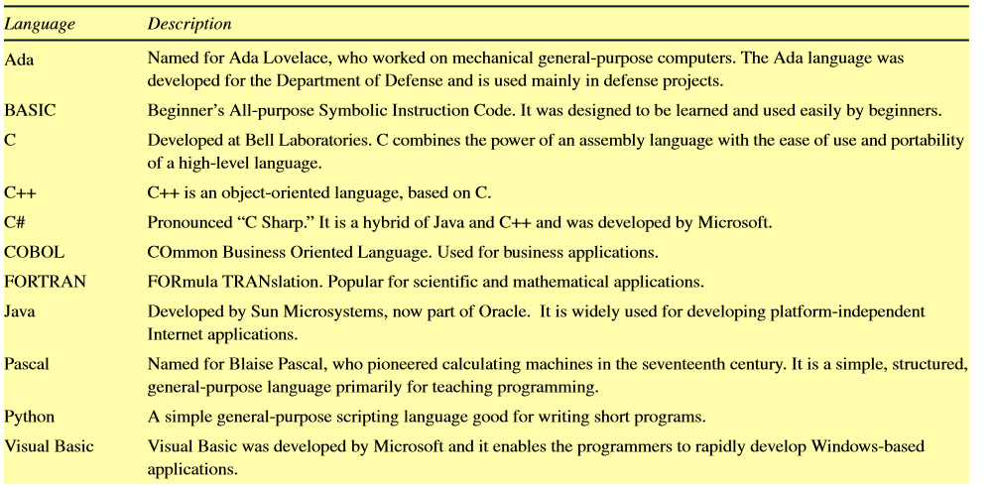
Popular high-level languages

Slide 13
Interpreter or compiler
A program written in a high-level language is called a source program or source code.
Because a computer cannot understand a source program, a source program must be translated into machine code for execution.
The translation can be done using another programming tool called an interpreter or a compiler.

Slide 14
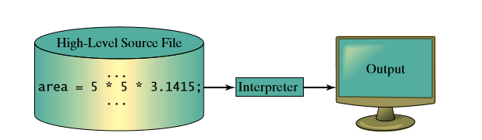
Interpreter
An interpreter reads one statement from the source code, translates it to the machine code or virtual machine code, and then executes it right away.

Slide 15
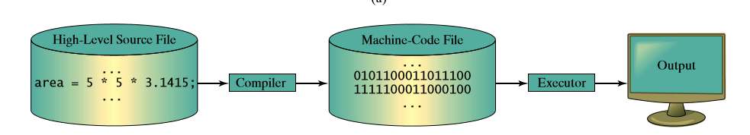
Compiler
A compiler translates the entire source program into a machine-language file for execution

Slide 16
Operating systems
The operating system (OS) is the most important program that runs on a computer.
The OS manages and controls a computer’s activities.
The popular operating systems for general-purpose computers are Microsoft Windows, Mac OS, and Linux.
Application programs, such as a Web browser or a word processor, cannot run unless an operating system is installed and running on the computer.
Users and applications access the computer’s hardware via the operating system.

Slide 17
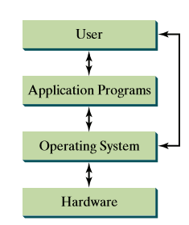
Interrelationship of hardware/OS/Software

Slide 18
Python
Python is a general-purpose, interpreted, object-oriented programming language.
Python was created by Guido van Rossum in the Netherlands in 1990 and was named after the popular British comedy troupe Monty Python’s Flying Circus.
Python is a general-purpose programming language.
That means you can use Python to write code for any programming task.
Python is now used in the Google search engine, in mission-critical projects at NASA, and in transaction processing at the New York Stock Exchange.
Python is interpreted, which means that Python code is translated and executed by an interpreter, one statement at a time.

